Slide 1
SESSION:18

Slide 2
Priority Interrupt
Direct Memory Access
Input Output Processors (IOP)
Serial Communication
Multiprocessors and their characteristics
Interconnection Structures

Slide 3
Priority Interrupt
A priority interrupt establishes a priority to decide which condition is to be serviced first when two or more requests arrive simultaneously. The system may also determine which conditions are permitted to interrupt the computer while another interrupt is being serviced. Higher-priority interrupt levels are assigned to requests, which if delayed or interrupted, could have serious consequences.

Slide 4
Priority Encoder
This circuit implements the priority function. The logic is that if two or more inputs arrive at the same time, the input having the highest priority will take precedence. The truth table of a four-input priority encoder is given in the Table 6.6. The x’s in the table designate don’t-care conditions. Input I₀ has the highest priority.

Slide 5
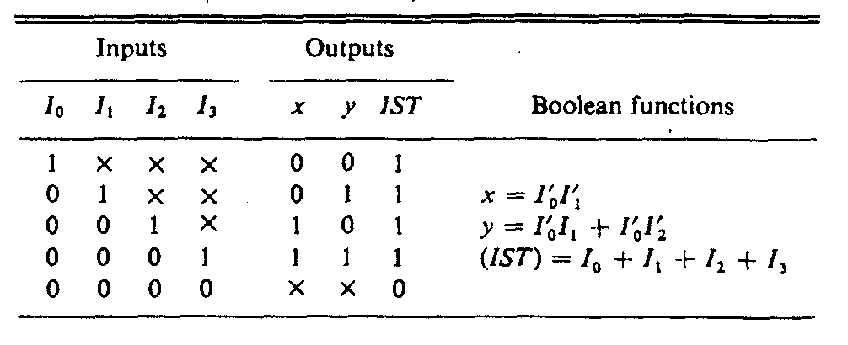

Slide 6
Direct Memory Access (DMA)
We can transfer data direct to and from memory without the need of the CPU. The transfer of data between a fast storage device such as magnetic disk and memory is often limited by the speed of the CPU. Removing the CPU from the path and letting the peripheral device manager the memory buses directly would improve the speed of transfer. This transfer technique is called direct memory access (DMA). During DMA transfer, the CPU is idle and has no control of the memory buses. A DMA controller takes over the buses to manage the transfer directly between the I/O device and memory.

Slide 7
DMA Controller
The DMA controller requires the usual circuits of an interface to communicate with the CPU and an I/O device. It also needs an address register, and count register, and a set of address lines. The address register and address line are used for direct communication with the memory. The word count register specifies the number of words that must be transferred. The data transfer may be done directly between the device and memory under control of the DMA.

Slide 8
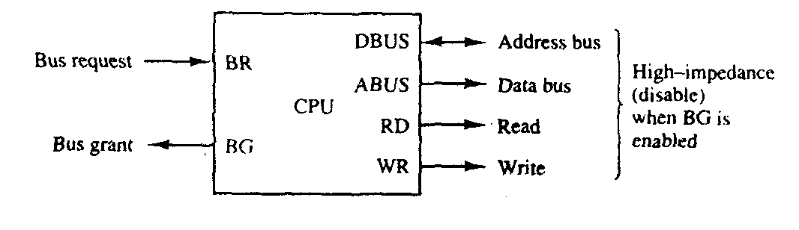

Slide 9
The DMA controller consists of three registers namely an address register, a word count register, and a control register. The address register contains an address to specify the desired location in memory. The address bits go through bus buffers into the address bus. The address register is incremented after each word that is transferred to memory. The word count register holds the number of words to be transferred. This register is decremented by one after each word transfer and internally tested for zero. The control register specifies the mode of transfer. All registers in the DMA appear to the CPU as I/O interface registers. Thus the CPU can read from or write into the DMA registers under program control via the data bus.

Slide 10
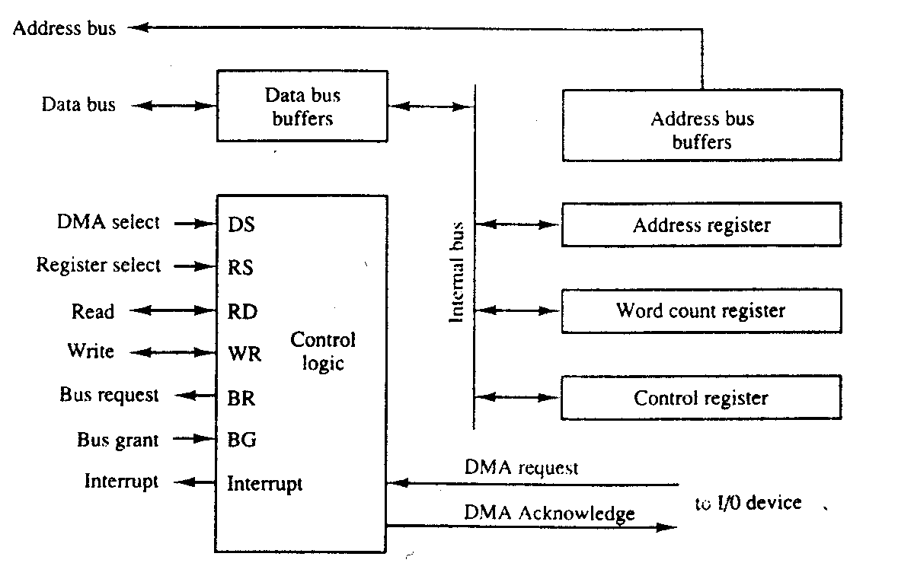

Slide 11
Input-output Processor (IOP)
A computer may incorporate one or more external processors and assign them the task of communicating directly with all I/O devices. An input-output processor (IOP) may be classified as a processor with direct memory access capability that communicates with I/O devices. In this configuration, the computer system can be divided into a memory unit, and a number of processors comprised of the CPU and one or more IOPs. Each IOP takes care of input and output tasks, relieving the CPU from the housekeeping chores involved in I/O transfers.

Slide 12
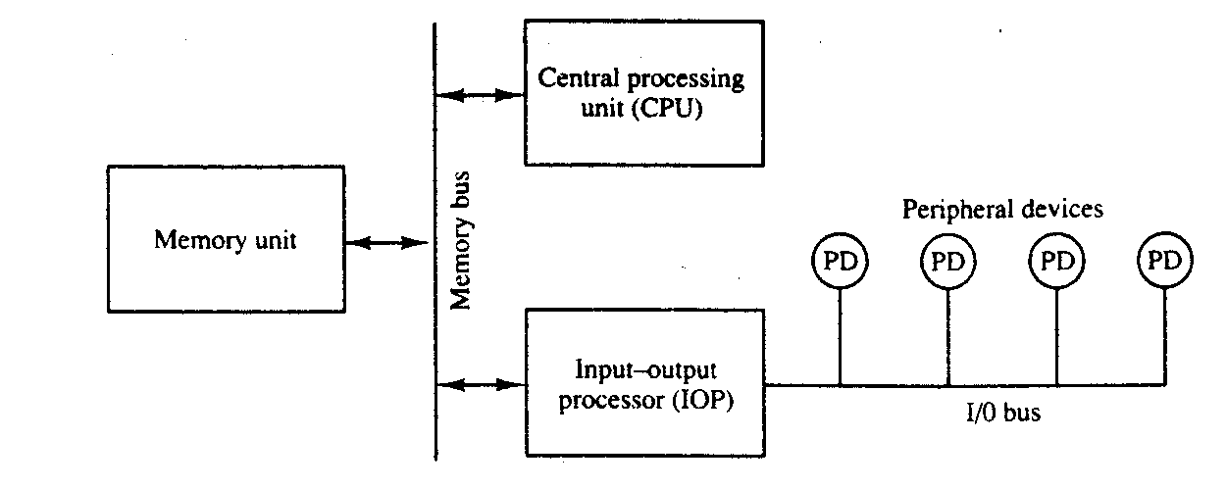

Slide 13
CPU-IOP Communication
There are many form of the communication between CPU and IOP. These are depending on the particular computer considered. In most cases the memory unit acts as a message center where each processor leaves information for the other. To appreciate the operation of a typical IOP, we will illustrate by a specific example the method by which the CPU and IOP communicate.

Slide 14
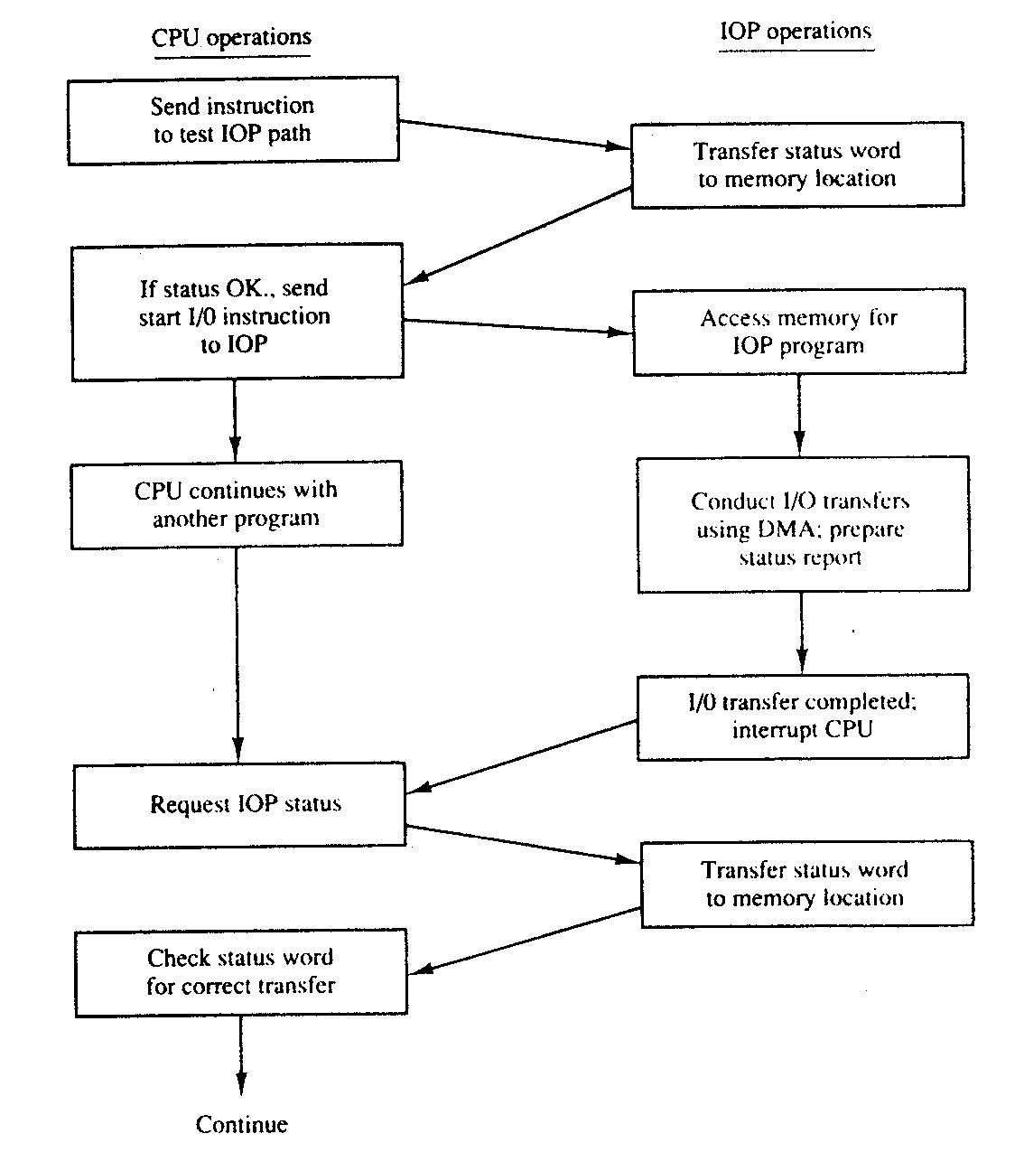

Slide 15
Multiprocessor/Characteristics of Multiprocessor
A multiprocessor system has two or more CPUs. It is an interconnection of two or more CPUs with memory and input-output equipment. The term "processor" in multiprocessor can mean either a central processing unit (CPU) or an input-output processor (IOP). However, a system with a single CPU and one or more lOPs is usually not included in the definition of a multiprocessor system unless the IOP has computational facilities comparable to a CPU. As it is most commonly defined, a multiprocessor system implies the existence of multiple CPUs, although usually there will be one or more lOPs as well. As mentioned earlier multiprocessors are classified as multiple instruction stream, multiple data stream (MIMD) systems.

Slide 16
Multiprocessing improves the reliability of the system so that a failure or error in one part has a limited effect on the rest of the system. If a fault cause one processor to fail, a second processor can be assigned to perform the functions of the disabled processor. The system as a whole can continue to function correctly with perhaps some loss in efficiency.

Slide 17
Time-Shared Common Bus
A common-bus multiprocessor system consists of a number of processors connected through a common path to a memory unit. Only one processor can communicate with the memory or another processor at any given time. Transfer operations are conducted by the processor that is in control of the bus at the time. Any other processor wishing to initiate a transfer must first determine the availability status of the bus, and only after the bus becomes available can the processor address the destination unit to initiate the transfer. A command is issued to inform the destination unit what operation is to be performed. The receiving unit recognizes its address in the bus and responds to the control signals from the sender, after which the transfer is initiated. The system may exhibit transfer conflicts since one common bus is shared by all processors. These conflicts must be resolved by incorporating a bus controller that establishes priorities among the requesting units.

Slide 18
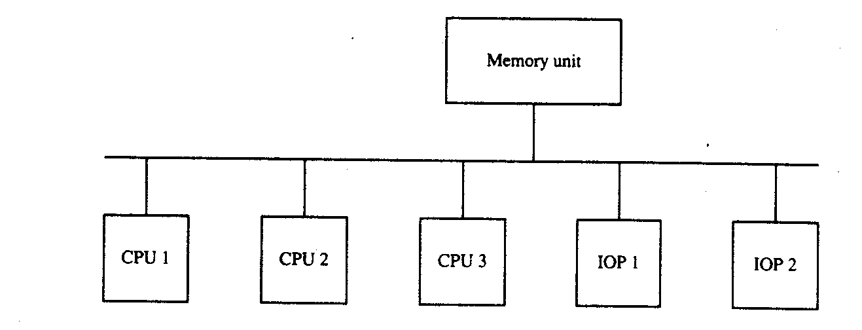

Slide 19
Only one processor can communicate with the shared memory and other common resources through the system bus of any time.

Slide 20
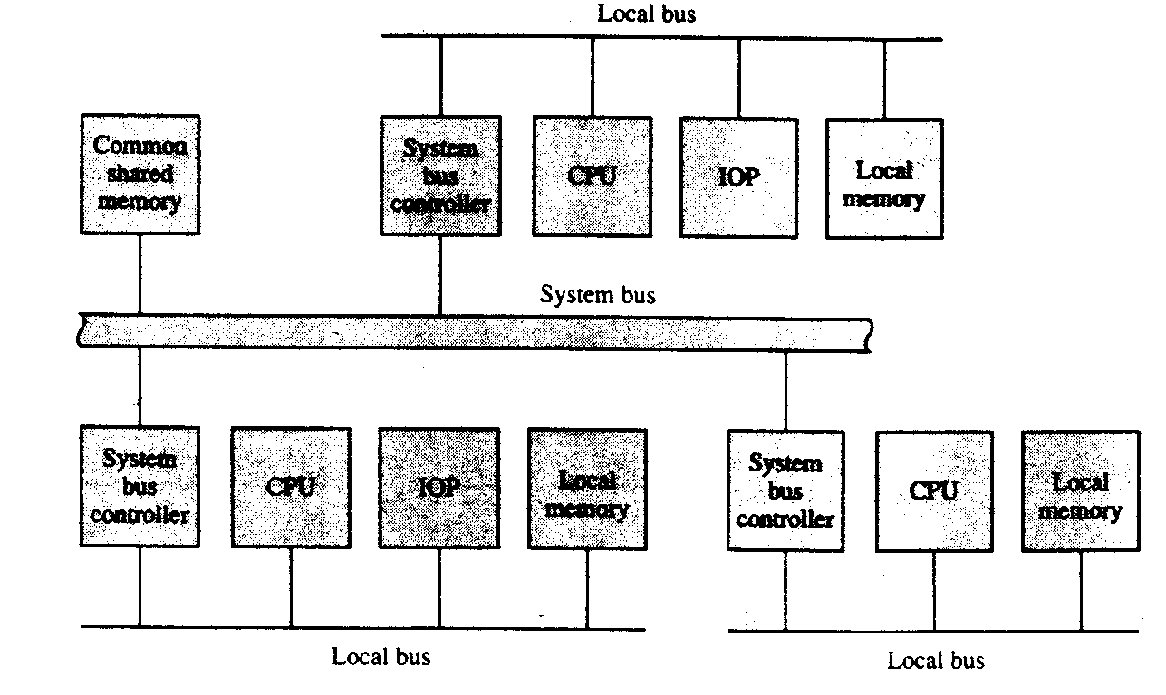

Slide 21
Multiport Memory
A multiport memory system employs separate buses between each memory module and each CPU. This is shown in Fig. 6.48 for four CPUs and four memory modules (MMs). Each processor bus is connected to each memory module. A processor bus consists of the address, data, and control lines required to communicate with memory. The memory module is said to have four ports and each port accommodates one of the buses.

Slide 22
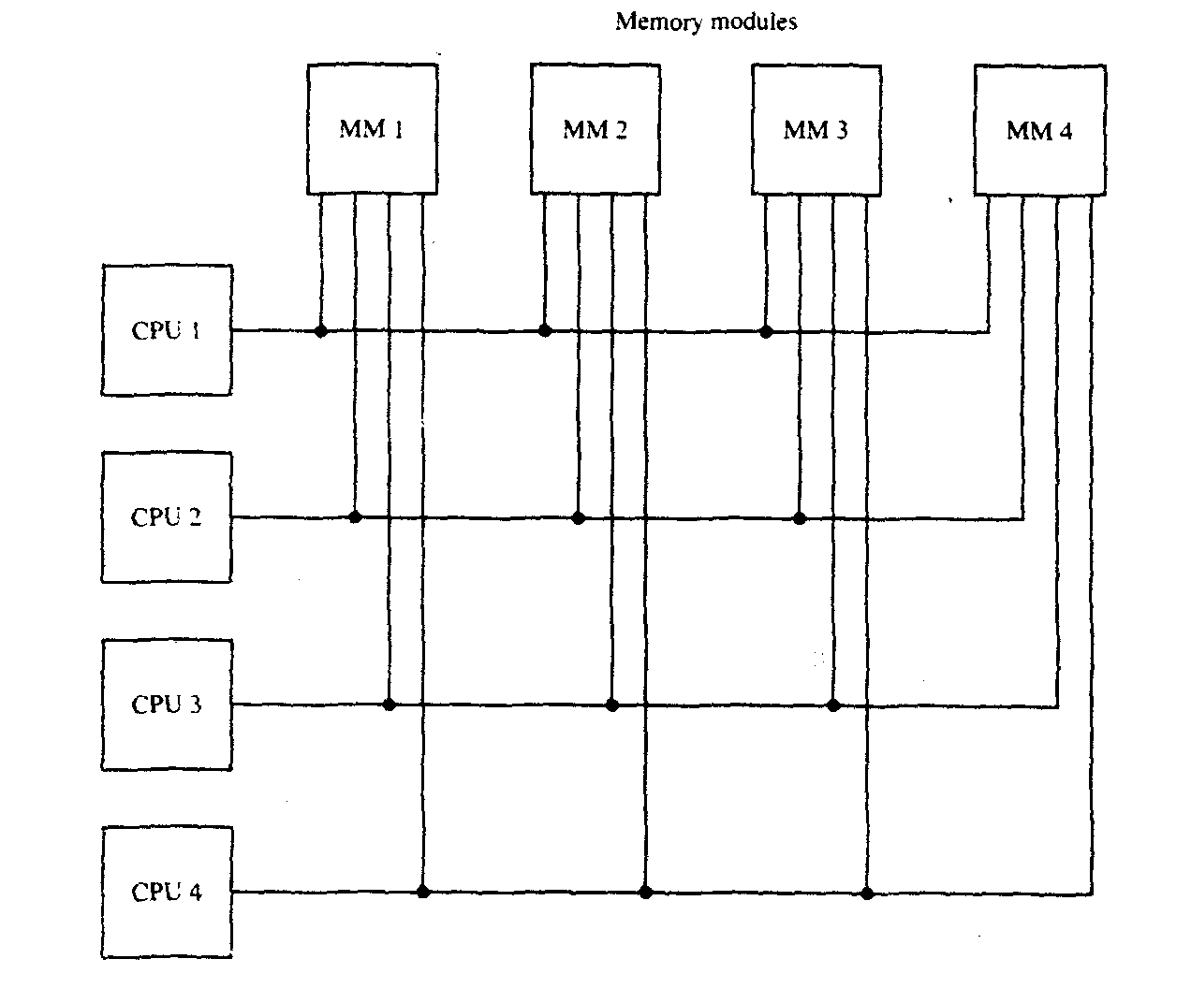

Slide 23
Crossbar Switch
The crossbar switch organization consists of a number of crosspoints that are placed at intersections between processor buses and memory module paths. Figure 6.49 shows a crossbar switch interconnection between four CPUs and four memory modules. The small square in each crosspoint is a switch that determines the path from a processor to a memory module. Each switch point has control logic to set up the transfer path between a processor and memory.

Slide 24
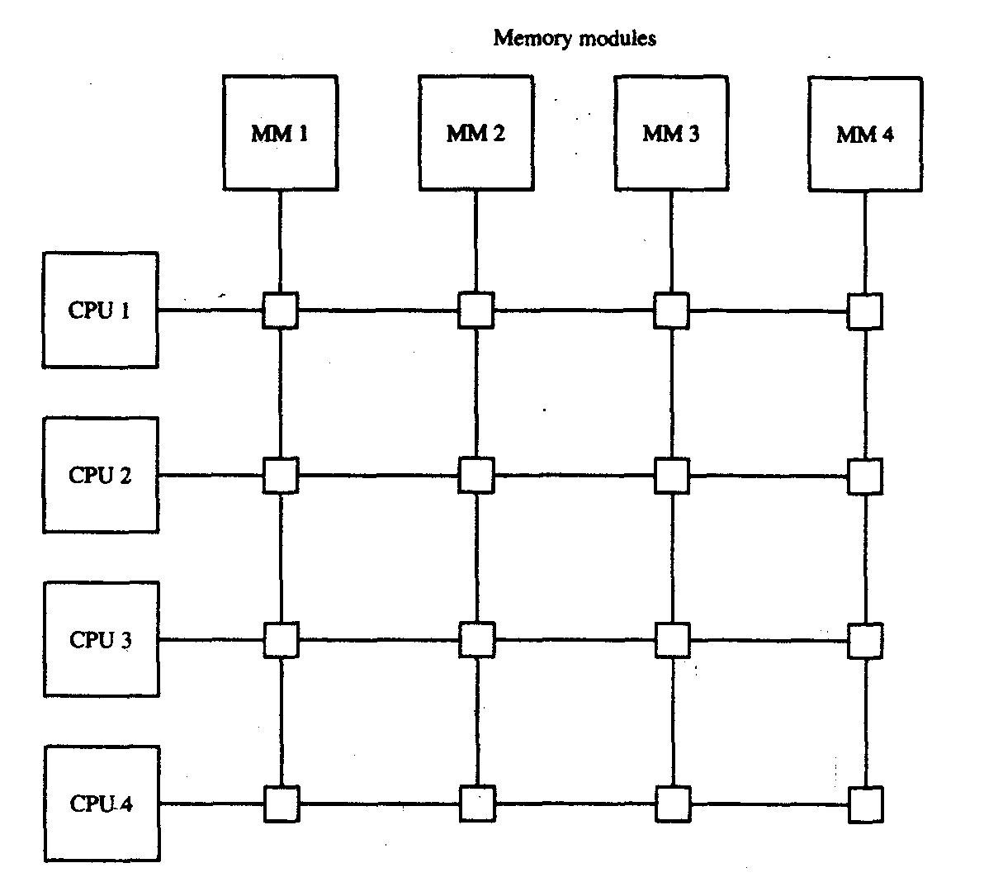

Slide 25
Multistage Switching Network
The basic component of a multistage network is a two-input, two-output interchange switch.
The switch has the capability of connecting input A to either of the outputs. Terminal B of the switch behaves in a similar fashion. The switch also has the capability to arbitrate between conflicting requests. If inputs A and B both request the same output terminal, only one of them will be connected; the other will be blocked.

Slide 26
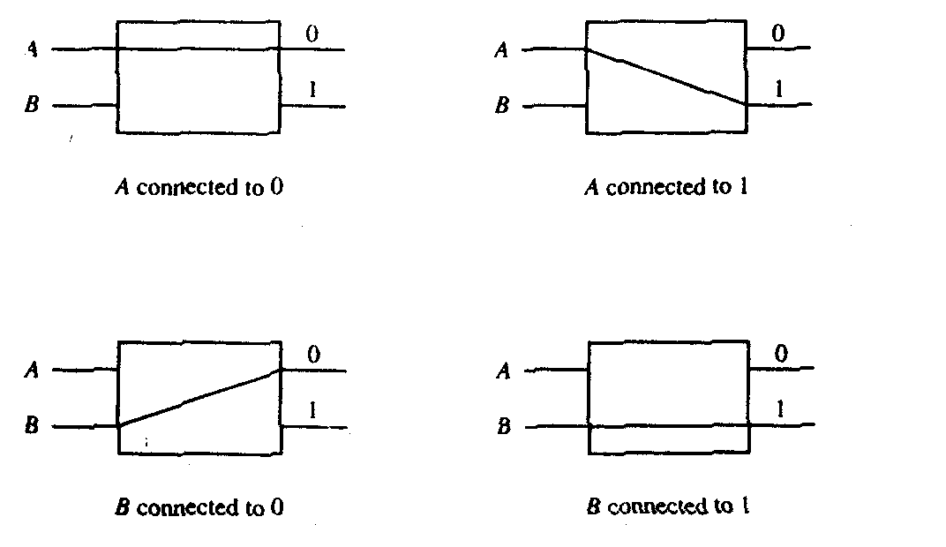

Slide 27
There is exactly one path from each source to any particular destination. Some request patterns, however, cannot be connected simultaneously. For example, any two sources cannot be connected simultaneously to destinations 000 and 001.
8x8 Omega Switching Network

Slide 28
